Slide 1
Phanish Puranam
Models in Organizational Science
Modeling Reinforcement Learning by Adaptive Agents: Replication Exercise

Slide 2
Replication exercise
A basic RL model with a single agent
Key element in Lave and March Chapter 6 (1975); Denrell and March, (2001); Posen and Levinthal (2012); Puranam and Swamy (2016); Lee and Puranam (2016).
With suitable modifications and extensions, the basic model can be useful to replicate/extend results in any of the papers above.

Slide 3
1. Task environment
Set of S alternatives A: {A₁, A₂… A_{S}}
Mapped to performance outcomes Π: {Π₁, Π₂… Π_{S}}
Π∗=1; other payoffs lie in [0,delta], where delta lies in [0,1]
To think about: What do S and delta mean? What kind of a task environment is this? Is there any relation among alternatives other than ordering in terms of payoffs?

Slide 4
2. Representation
Attractions for S alternatives : {π_{1,t}, π_{2,t}… π_{S,t}}
Initial attractions (“priors”) are drawn from uniform distribution in [0,1]
To think about: What do these random priors imply? What does it mean that representation is also of dimension S?

Slide 5
3. Choice
Softmax over Attractions for τ>0.01
To think about: What would increasing τ do? What would it capture?

Slide 6
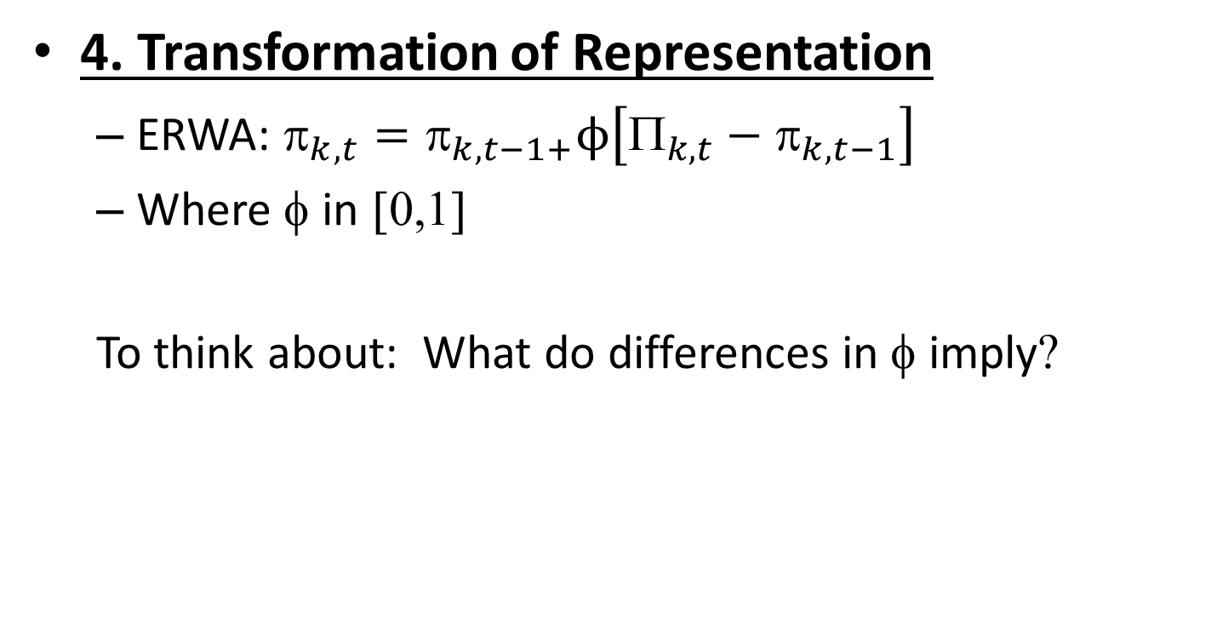
4. Transformation of Representation
ERWA: ${\text{p}}_{k,t}={\text{p}}_{k,t−1+}ϕ\left[{\text{P}}_{k,t}−{\text{p}}_{k,t−1}\right]$
Where φ in [0,1]
To think about: What do differences in φ imply?

Slide 7
Assignment
Compute model for T=100 periods, N=10,000 trials
Four outputs
Performance over time (average payoff in each period across trials)
Cumulative Performance over time (average cumulative payoff in each period across trials)
Standard deviation of Performance across trials, over time
Search success (per period average across trials of instances of finding the global peak i.e. payoff=1)
Q1. Reproduce graphs overleaf
Q2. Explore model behavior for variations in task environment (S, delta) and agent properties (tau, phi); explain your results
Q3. Extensions:
Convert Task Environment into a “Bernoulli bandit” – payoffs are 0 or 1 for each alternative with probabilities drawn from a uniform distribution in [0,1] (easy- about 1 hour)
Make action selection “local”; choice is restricted to neighborhood of previous choice (harder- 3-4 hours)

Slide 8
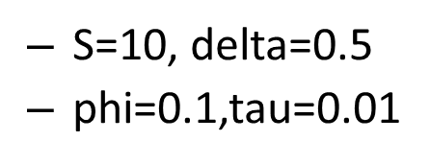
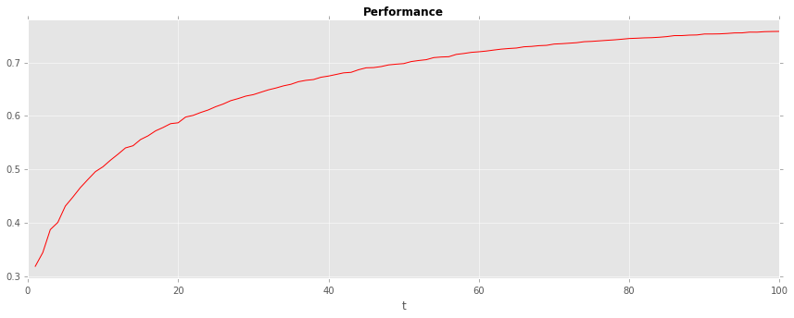
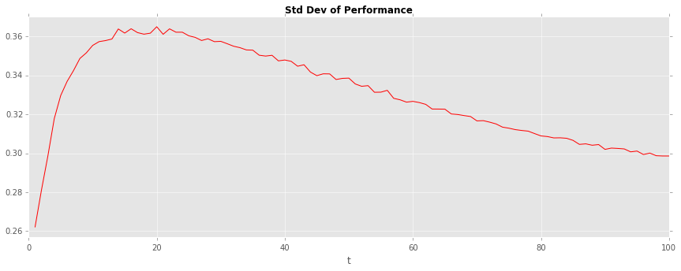
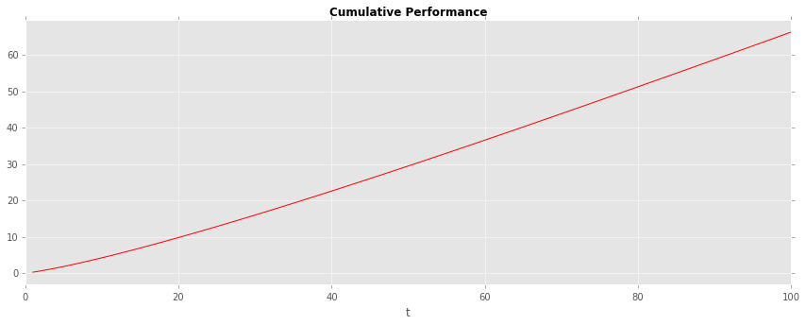
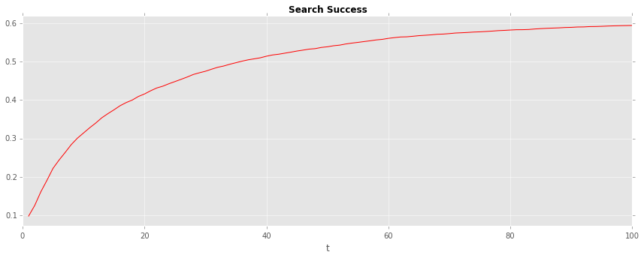

Slide 9
Suggestion
As you attempt the replication, some resources for you to draw on:
pseudo-code and actual python syntax for key steps (in next few slides)
A working version of the model in python itself (RLReplication.py)

Slide 10
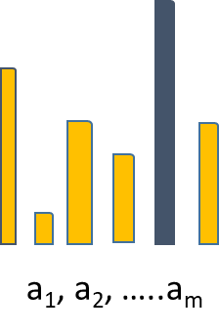
Task environment – two parameters
Pseudo code
Create a 1X S vector
Assign random values from a uniform distribution in [0, delta] to each cell in this vector (where delta is in [0,1])
Randomly assign a payoff of “1” to one cell
1
delta

Slide 11
Python code for creating task environment
def environment(d): #setting environment
if d==0:
env=np.zeros((1,S))
else:
env=0.01*(np.random.choice(int(100*d),(1,S),replace=True))
col1=random.randint(0, S-1)
env[0,col1]=1 # One global peak
return env

Slide 12
Action selection – softmax
Pseudo code
Create denominator: add up exponentiated (attraction/tau) for all alternatives
Draw a random number roulette from [0,1]
Set p=0
For each alternative #roulette wheel
calculate its probability of selection prob_{a}= exponentiated (attraction/tau)/denominator
p=p + prob_{a}
Is p>roulette?
If YES: current action is your final choice; STOP
IF NO: Go to 4.
0
0.2
0.8
1.0

Slide 13
Python code for softmax
def softmax(attraction): #softmax action selection module
prob=np.zeros((1,M))
denom=0
for i in range(M):
denom=denom + math.exp((attraction[i])/tau)
roulette=random.random()
p=0
for i in range(M):
prob[0,i]=math.exp(attraction[i]/tau)/denom
p= p+ prob[0,i]
if p>roulette:
choice= i
return choice
break #stops computing probability of action selection as soon as cumulative probability exceeds roulette

